Slide 1

SKIN JOB
Data Model Dermatology
Name: Gong Qi Chen, Huihuang Liu
Course: DSE I2100
Instructor: Michael Grossberg

Slide 2
Introduction
Project Overview
Research Purpose
Why We Cares
Data introduction
Exploratory Data Analysis
Methods
Evaluation
Conclusion
Notes:
Melanocytic nevi (nv)
Melanoma (mel) - malignant
Benign keratosis-like lesions (bkl)
Basal cell carcinoma (bcc) - malignant
Actinic keratoses (akiec)
Vascular lesions (vasc)
Dermatofibroma (df)

Slide 3
Project Overview
In this project, we incorporated a series of machine learning techniques to help us build a model that can distinguish skin cancers from other tumors. A convulsion neural network model was selected and built with the accuracy of matching human benchmark. Alongside, we also identified few key features that affect the model Training.

Slide 4
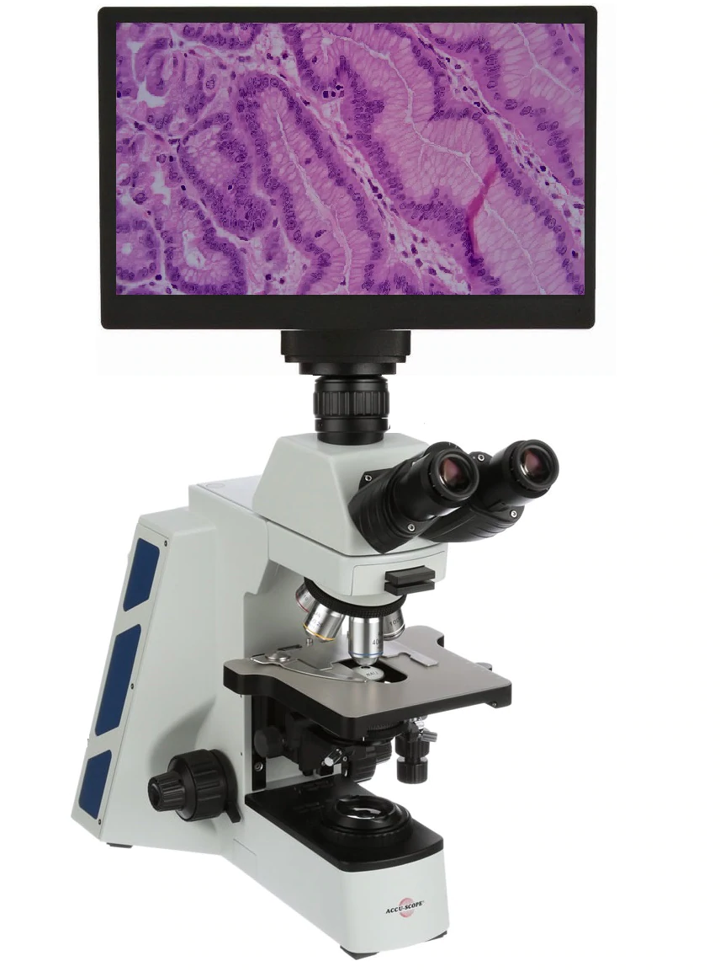

Research Purpose
Objective:
Use image data to classify skin lesions
Emphasize on recall and precision rate of skin cancers
Benchmark:
Human accuracy: 67-75%
Our goal
Match or better human benchmark
Achieve higher F1 score for skin cancers

Slide 5
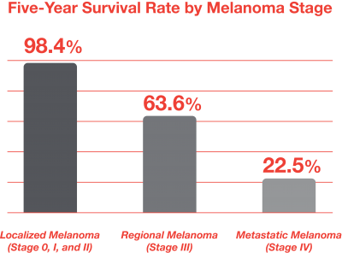

Why we care?
Limited screening methods
Once malignancy is confirmed, usually late stage
Accurate skin cancer detection at earlier stage is the key:
Improved survival
Improved clinical outcomes
Improved quality of life

Slide 6
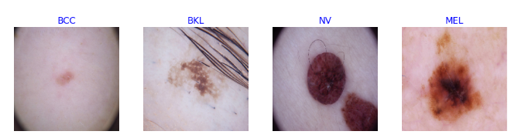
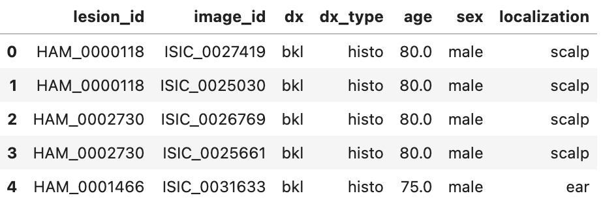
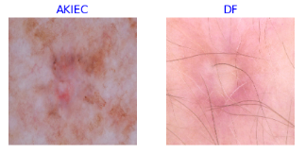
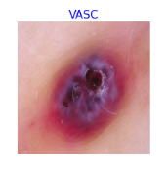
Data Introduction
Dataset: HAM10000: Human Against Machine with 10000 training images
What:
10015 dermatoscopic images
Types of label: 5 benign + 2 malignant
Benign: (AKIEC, BKL, DF,NV, VASC), Malignant: (BCC, MEL)
NV most common label
Variables:
lesion_id, image_id, dx, dx_type, age and localization
Notes:
Melanocytic nevi (nv)
Melanoma (mel)
Benign keratosis-like lesions (bkl)
Basal cell carcinoma (bcc)
Actinic keratoses (akiec)
Vascular lesions (vasc)
Dermatofibroma (df)

Slide 7

Data Introduction
Who:
International Skin Imaging Collaboration (ISIC) archive
Standard source for dermatoscopic image analysis research
When: 2018 challenges
Why: Enhance the diagnostic accuracy for distinguishing melanoma from other tumors

Slide 8
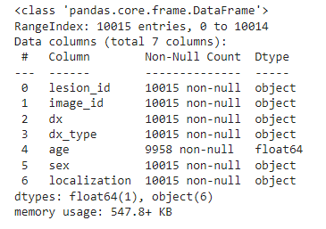
Exploratory Data Analysis
Missing Data in Age
Replaced with average mean

Slide 9
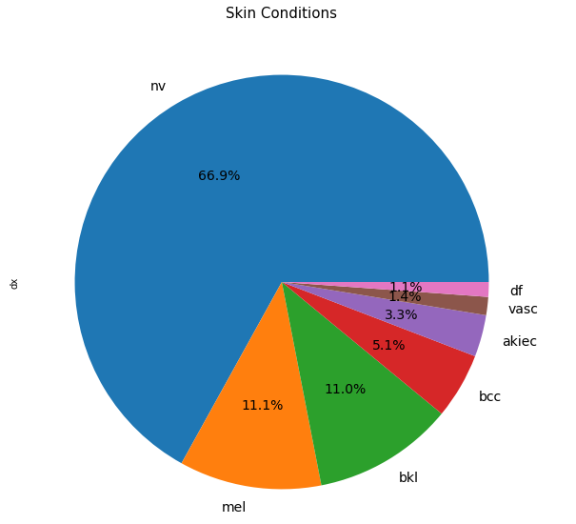
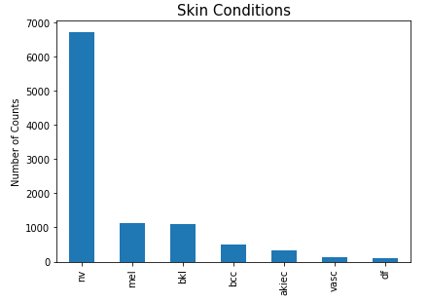
EDA - Imbalance Data

Slide 10
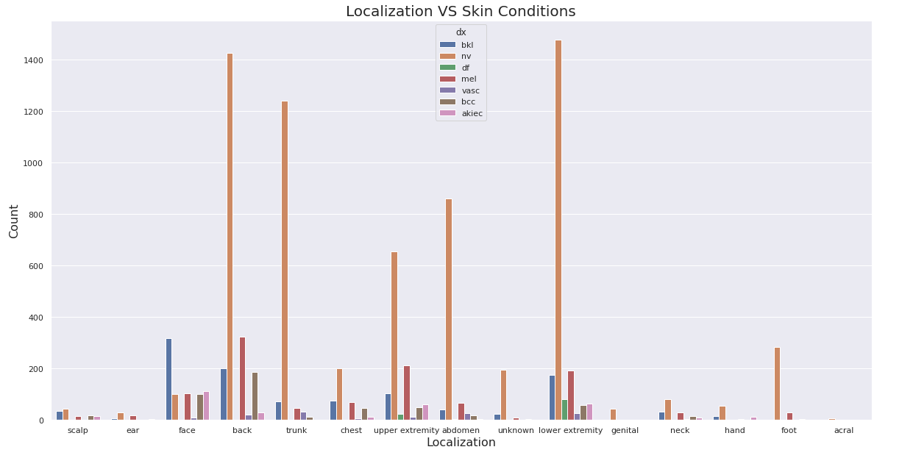
EDA - Bivariate Analysis

Slide 11
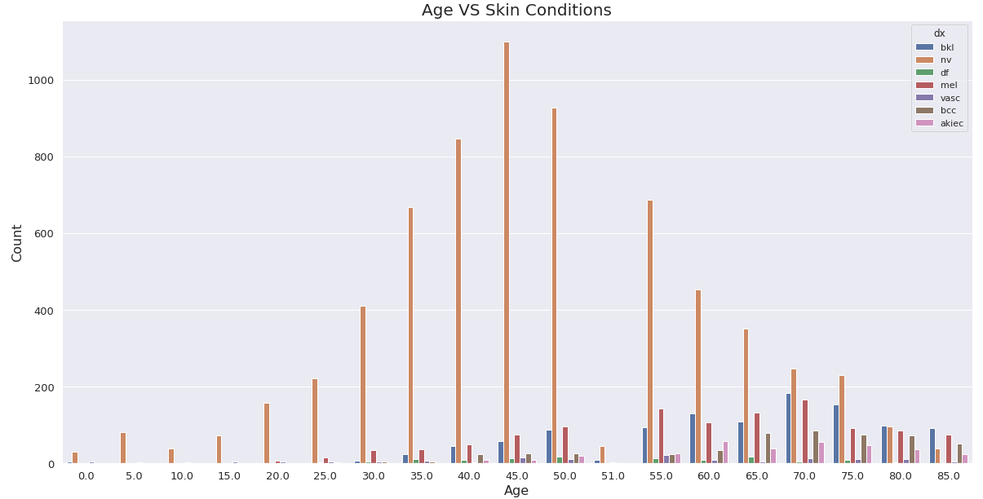
EDA - Bivariate Analysis

Slide 12
Feature Selection
Image Data
90x90
Age
Localization
Model Improvement with Age and Localization:
Models | Val accuracy | Mel F1 Score | Bcc F1 Score
Ridge Classifier | 9.30% | 0.11 | 0.1
Logistic Classifier | 11.81% | 0.16 | 0.04
SVC | 9.02% | 0.05 | 0.12
Random Forest | 7.51% | 0.04 | 0.05
DNN | 3.65% | 0.15 | 0.03
CNN (EfficientNet B1) | 0.27% | -0.02 | 0.02

Slide 13
Pipeline Flow Chart
Data
Data Extraction
EDA
Data Cleaning
Data Preprocessing
Weight Calculation
Data Augmentation
Train Test Split
Normalize/rescale
Undersample
Trained Model
Model Selection
Hyperparameter Tuning
Model Training
Model Evaluation

Slide 14
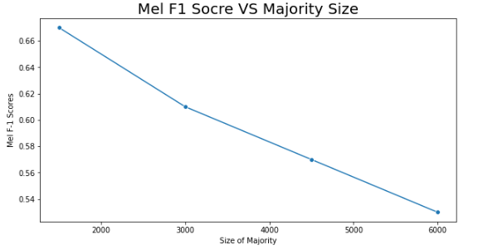
Undersample

Slide 15
Model Selection
Sklearn Models
Ridge Classifier
Logistic Classifier
SVC
Random Forest
Keras Models
DNN (Dense Neural Network)
CNN (Convolutional Neural Network)
CNN with EfficientNetB1

Slide 16
Model Selection
Models | Val accuracy | Mel F1 Score | Bcc F1 Score | Train - Val
Ridge Classifier | 62.06% | 0.45 | 0.33 | 8.14%
Logistic Classifier | 67.57% | 0.50 | 0.43 | 11.36%
SVC | 72.72% | 0.49 | 0.55 | 16.88%
Random Forest | 68.93% | 0.48 | 0.35 | 11.57%
DNN | 71.65% | 0.42 | 0.34 | 2.39%
CNN | 75.23% | 0.45 | 0.48 | 7.59%
CNN (EfficientNet B1) | 81.53% | 0.55 | 0.62 | 15.42%

Slide 17
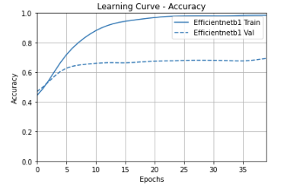
Learning Curve - Accuracy

Slide 18
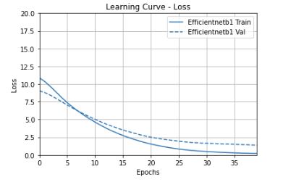
Learning Curve - Loss

Slide 19
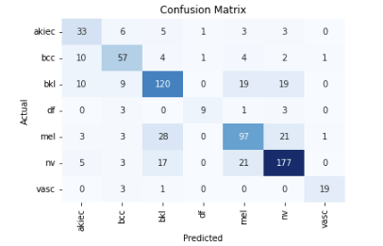
Confusion Matrix
Mel: 97 out of 153
Bcc: 57 out of 79

Slide 20
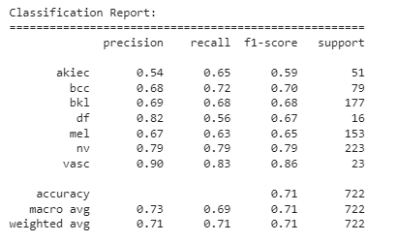
Classification Report

Slide 21
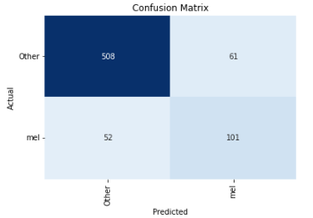
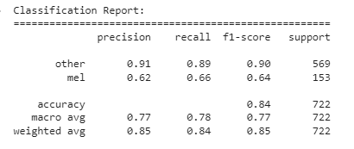
One vs Rest - Mel

Slide 22
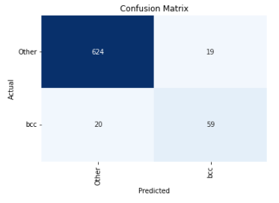
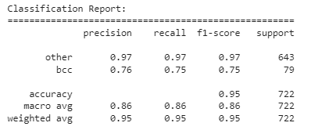
One vs Rest - Bcc

Slide 23
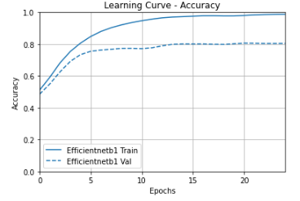
On High Resolution

Slide 24
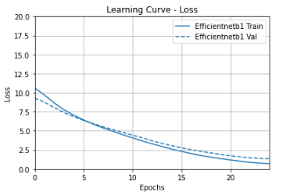
On High Resolution

Slide 25
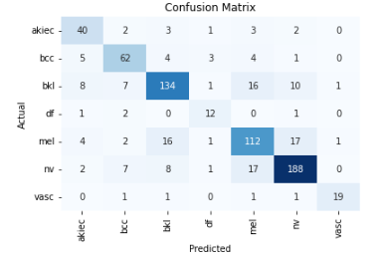
On High Resolution
Mel: 122 out of 153
Bcc: 62 out of 79

Slide 26
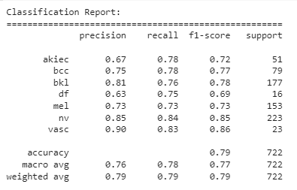
On High Resolution

Slide 27
Conclusion
Model:
Data preprocessing technique is effective
Our model is matching with human benchmark
Findings:
Age and localization are very effective in model training
One vs Rest is effective for Bcc, but not Mel
Limitations:
Dataset suffer from biases: light skins
More risk factor features will improve model accuracy: family history, pre-existing condition

Slide 28
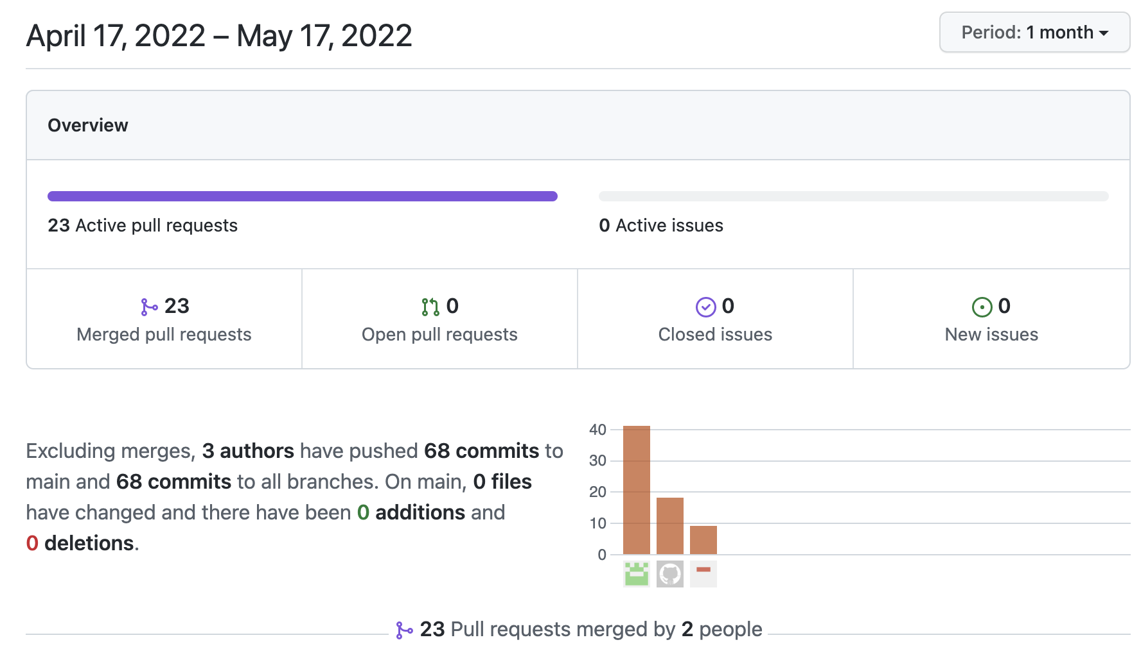
Attribute

Slide 29
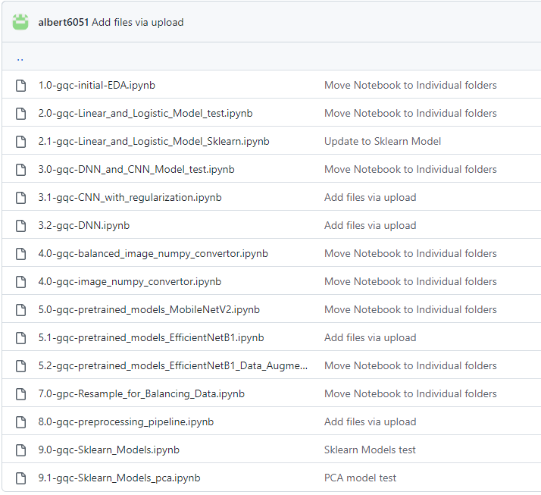
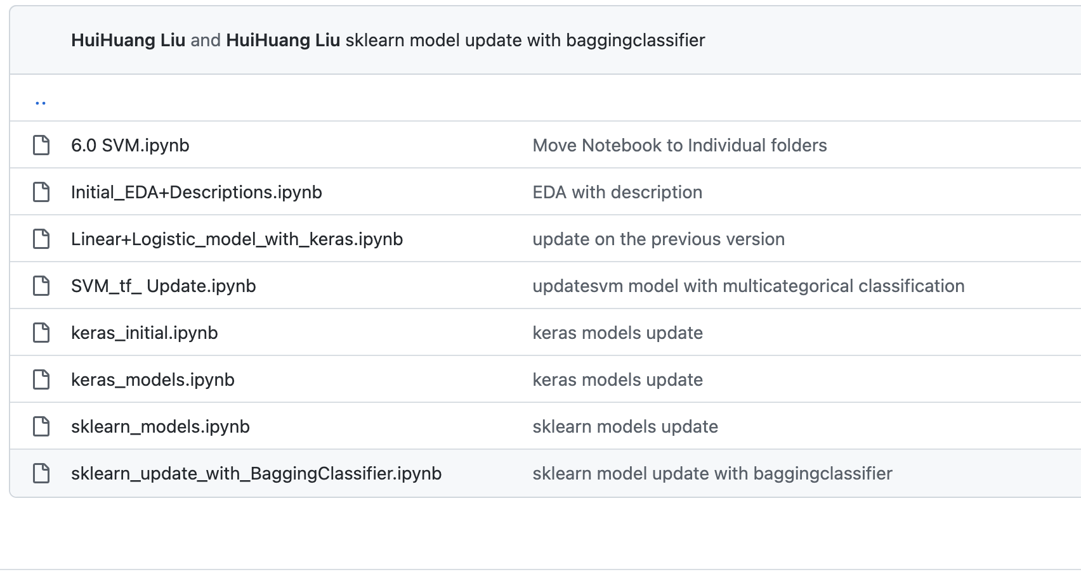
Notebook List

Slide 30
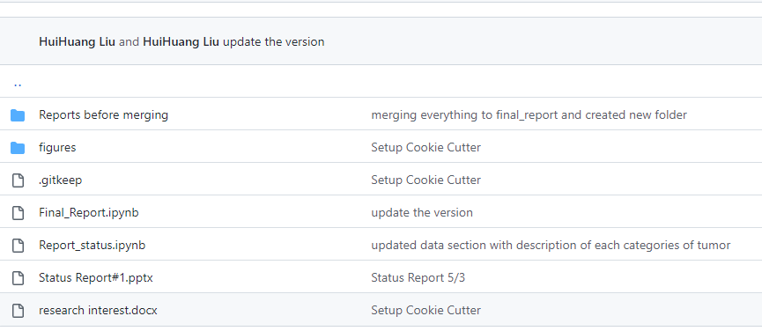
Reports

Slide 31
Reference
Rosendahl, C., Tschandl, P., Cameron, A. & Kittler, H. Diagnostic accuracy of dermatoscopy for melanocytic and nonmelanocytic pigmented lesions. J Am Acad Dermatol 64, 1068–1073 (2011).
Bechelli S, Delhommelle J. Machine Learning and Deep Learning Algorithms for Skin Cancer Classification from Dermoscopic Images. Bioengineering (Basel). 2022;9(3):97. Published 2022 Feb 27.
Binder, M. et al. Application of an artificial neural network in epiluminescence microscopy pattern analysis of pigmented skin lesions: a pilot study. Br J Dermatol 130, 460–465 (1994).
Codella, N. C. F. et al. Skin Lesion Analysis Toward Melanoma Detection: A Challenge at the 2017 International Symposium on Biomedical Imaging (ISBI), Hosted by the International Skin Imaging Collaboration (ISIC). Preprint at https://arxiv.org/abs/1710.05006 (2017).
Deng, J. et al. ImageNet: A large-scale hierarchical image database, 2009 IEEE Conference on Computer Vision and Pattern Recognition, Miami, FL, 2009, pp. 248–255 (2009).
Tschandl, P., Rosendahl, C. & Kittler, H. The HAM10000 dataset, a large collection of multi-source dermatoscopic images of common pigmented skin lesions. Sci Data 5, 180161 (2018).
Dreiseitl, S., Binder, M., Hable, K. & Kittler, H. Computer versus human diagnosis of melanoma: evaluation of the feasibility of an automated diagnostic system in a prospective clinical trial. Melanoma Res 19, 180–184 (2009).
Kharazmi, P., Kalia, S., Lui, H., Wang, Z. J. & Lee, T. K. A feature fusion system for basal cell carcinoma detection through data-driven feature learning and patient profile. Skin Res Technol 24, 256–264 (2017).
Sinz, C. et al. Accuracy of dermatoscopy for the diagnosis of nonpigmented cancers of the skin. J Am Acad Dermatol 77, 1100–1109 (2017).
Esteva, A. et al. Dermatologist-level classification of skin cancer with deep neural networks. Nature 542, 115–118 (2017).
Han, S. S. et al. Classification of the clinical images for benign and malignant cutaneous tumors using a deep learning algorithm. J Invest Dermatol, Preprint at https://doi.org/10.1016/j.jid.2018.01.028 (2018).

